Slide 1

CINEAPP – PROJECT DEMO
TAU NHAT QUANG

Slide 2
Agenda
Requirement Overview
Functional and Non-Functional Requirements
System Modeling
Use Case Diagram
Class Diagram
Architectural Design
Architectural Pattern
Deployment View
Testing
Unit Testing
Component Testing
System Testing

Slide 3
REQUIREMENT Overview
Functional and Non-functional requirements

Slide 4

Functional REQUIREMENTS
User should be able to view the list of movies
User should be able to select or delete the seat.
User should be able to access to a movie.
User should be able to choose film shot period.
User should be able to handle the room information.
User should be able to view the sales statistics

Slide 5
NON-Functional REQUIREMENTS
Statistics should be accurate.
Room information should be stored.
UI should be quick response.
The application should be opened 24/7 during operation.

Slide 6
SYSTEM MODELING
Use Case Diagram
Class Diagram

Slide 7

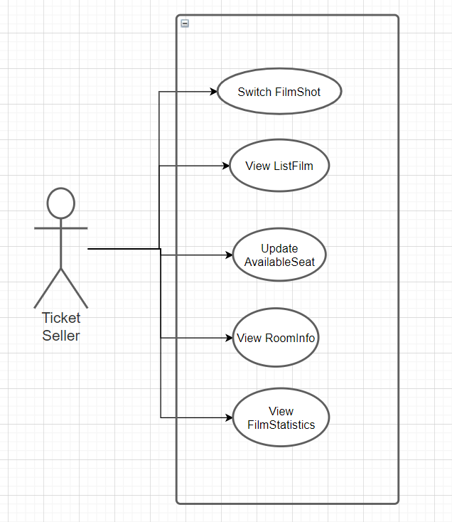
Use case Diagram

Slide 8
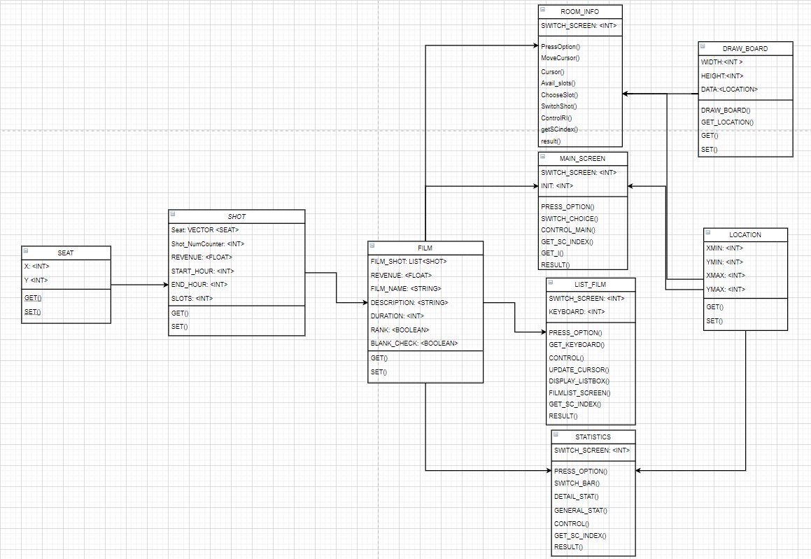
Class diagram

Slide 9
Architectural design
Deployment View

Slide 10
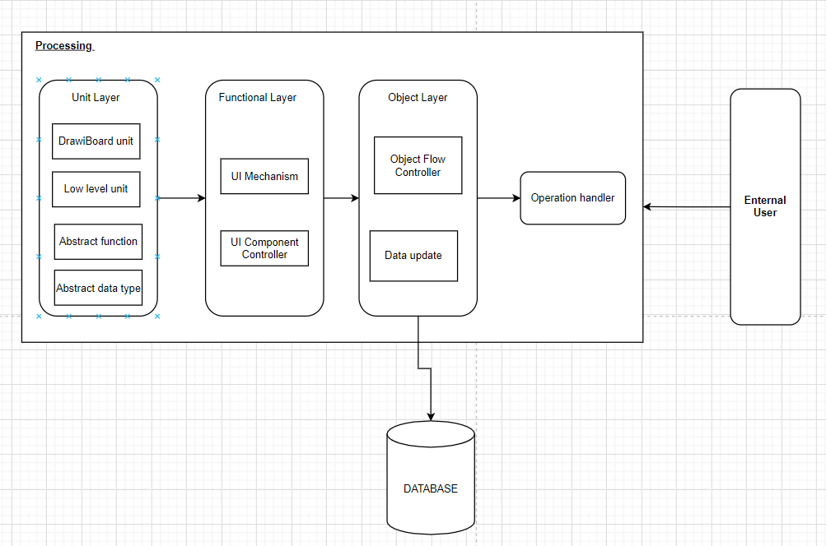
Deployment view

Slide 11
TESTing
Unit Testing
Component Testing
System Testing

Slide 12
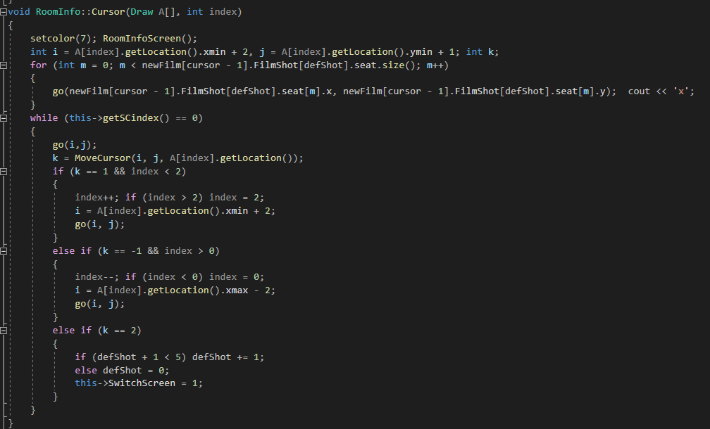
Unit testing
National
Domestic
International

Slide 13
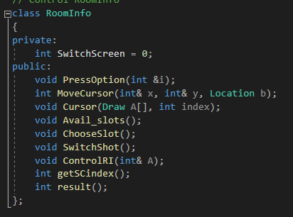
COMPONENT testing
National
Domestic
International

Slide 14
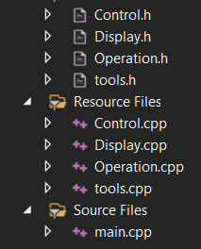
SYSTEM testing
National
Domestic
International

Slide 15
Thank you

